Slide 1
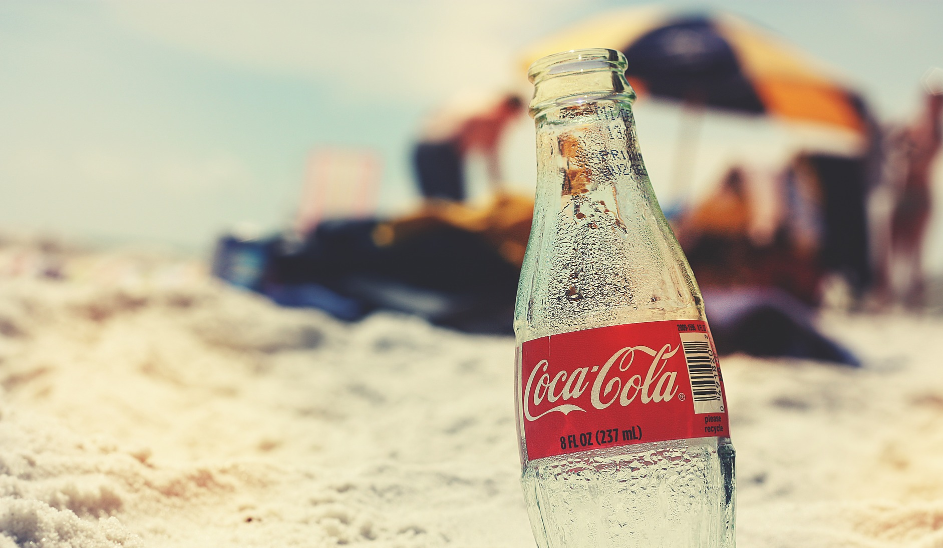

최현서
정준영
김지혜
Loyachi
Zhou Keyang
Anastasiya Zabolotnaya

Slide 2
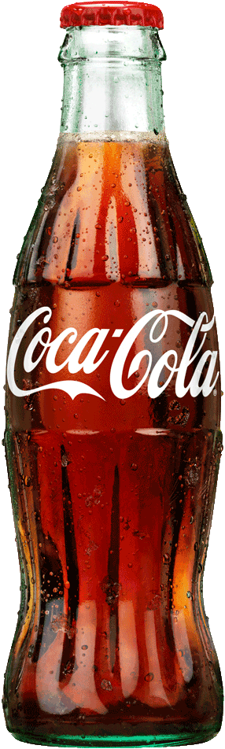
Contents
1. About Coca-Cola
2. Marketing Implications
3. Standardization & localization strategy
4. Australia’s success & failure
5. China’s success & failure
6. SWOT analysis
7. Suggestion

Slide 3
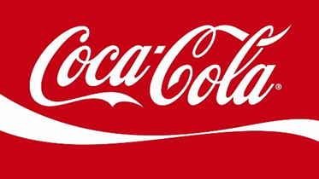
ABOUT

Slide 4




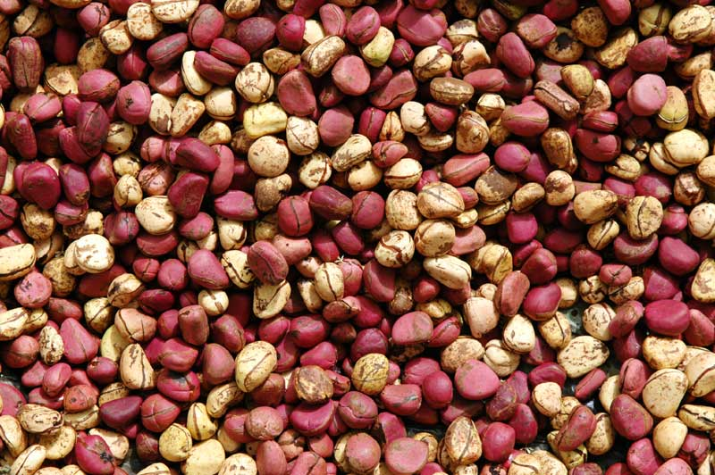

About Coca-Cola
1
The Secret of the name of Coca-Cola
Coca leaves Kola nuts

Slide 5
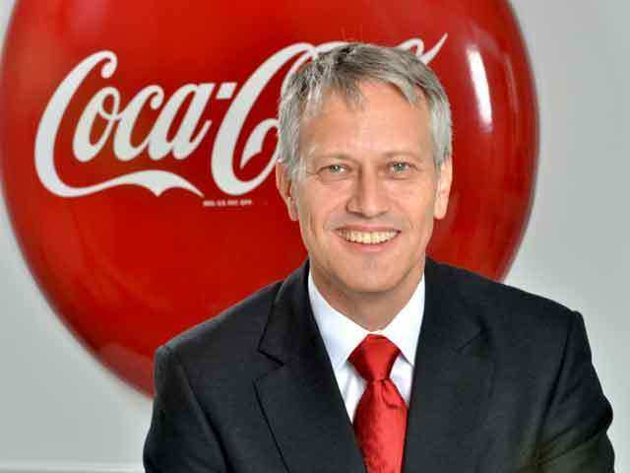
About Coca-Cola
1
Brand Name
Coca-Cola
(Coca leaves +Kola nuts)
In 1892
In Atlanta
Beverages for everyone
in the world
established
Management CONCEPT
President: James Quincey

Slide 6
About Coca-Cola
1
people
portfolio
partners
profit
productivity
planet
Notes:
Our Vision
Our vision serves as the framework for our Roadmap and guides every aspect of our business by describing what we need to accomplish in order to continue achieving sustainable, quality growth.
People: Be a great place to work where people are inspired to be the best they can be.
Portfolio: Bring to the world a portfolio of quality beverage brands that anticipate and satisfy people's desires and needs.
Partners: Nurture a winning network of customers and suppliers, together we create mutual, enduring value.
Planet: Be a responsible citizen that makes a difference by helping build and support sustainable communities.
Profit: Maximize long-term return to shareowners while being mindful of our overall responsibilities.
Productivity: Be a highly effective, lean and fast-moving organization.

Slide 7
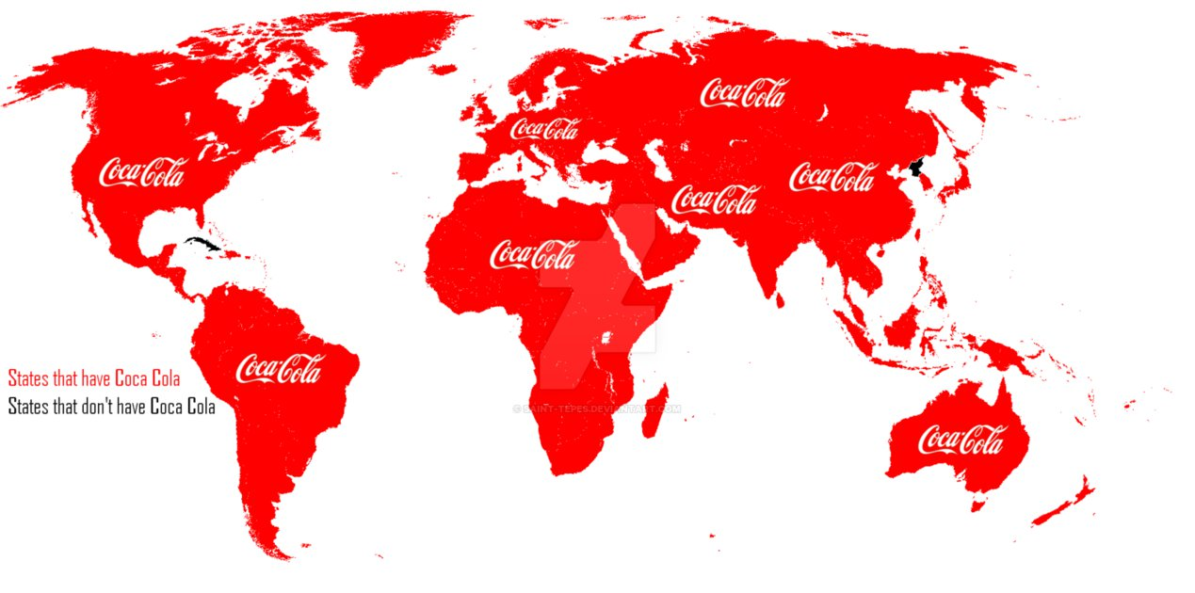
About Coca-Cola
1
Overseas markets
More than 200 countries
Except Cuba and North Korea

Slide 8
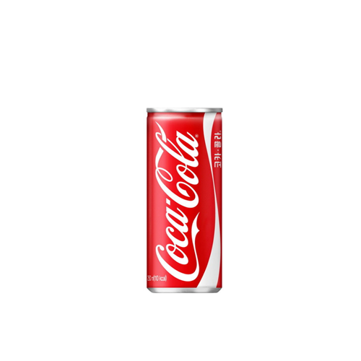
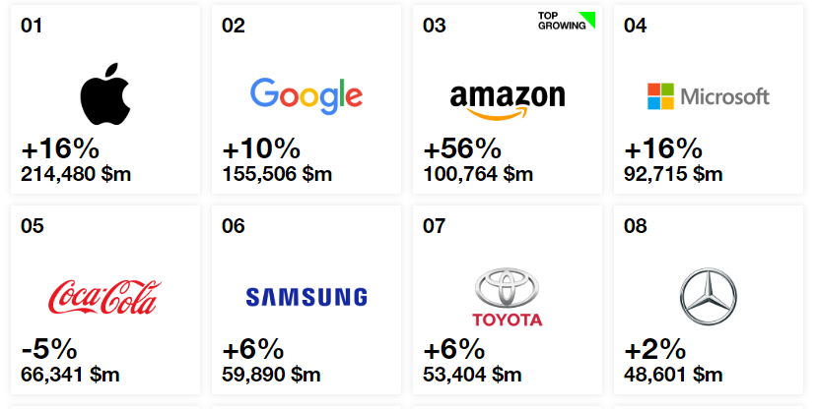
About Coca-Cola
1
2005 $23,104 2012 $48,017 2018 $31,856
Notes:
2018년 인터브랜드에서 선정한 2018 전세계 100대 브랜드중 5위

Slide 9
MARKETING
IMPLICATIONS

Slide 10

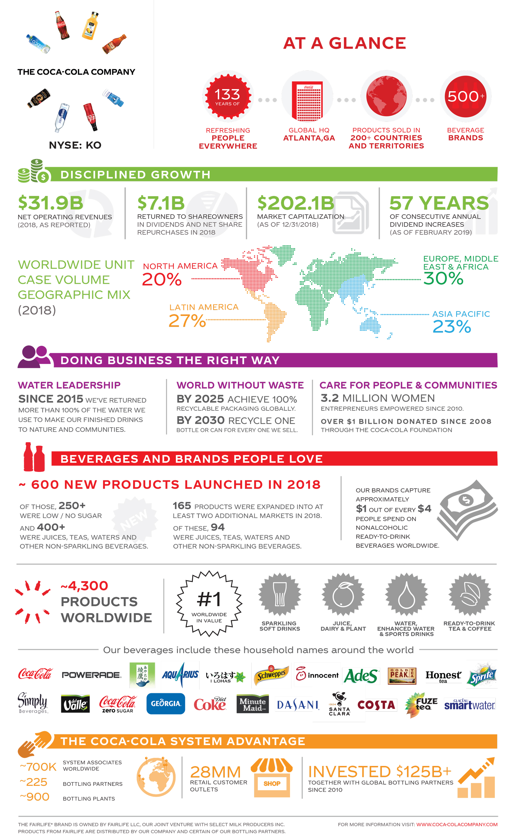
Marketing Implications
2

Slide 11
Marketing Implications
2

Slide 12



Marketing Implications
2
Availability
Affordability
Acceptability
Coca-Cola has built its business
using a universal strategy based on these three principles

Slide 13
Marketing Implications
2
4P Marketing Mix
Product
Place
Product Diversification
Two levels in its distribution strategy
Various packaging and sizes
Excessive distribution network
Promotion
Price
Aggressive marketing
2nd degree price discrimination strategy
various CSR activities
Notes:
audio측면에서 설명하려 한다.
‘우리가 해석하기로는’ 전체적으로 광고의 주제는 - We are different but there is coke for we 이다.
코카는 upbeat노래를 배경으로 말이 주를 이루어 광고를 이끔으로서 표현
구체적으로
Let’s see this with watching the ad one more time.
중간에 음악을 잠깐 멈추고 ‘That’s why there’s just one me’ 라 함으로써
그만큼 이 세상에 나는 단 하나다 라는 것을 강조하면서도
마지막에 But there is coke for we and us. Coke for you 라 함으로써
우리를 위한 coke라는 것을 되새겨준다.
Hi I am Jihyun Lee and I will talk about tones and moods in aspect of audio.
As our interpretation, the topic of this advertisement is this.
‘We are all different but there is coke for we.’
To express this, they use different voices per phrase.
Also Coca-cola show this topic by using upb
Then let’s see more specific things with watching the Ad one more time.
Did you hear this? By pausing the music for a while, they make the sentence ‘That’s why there’s just one me.’ more impressive.

Slide 14
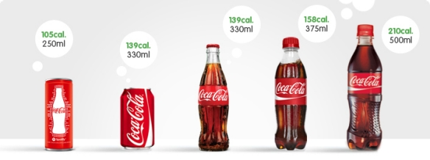
Marketing Implications
2
4P Marketing Mix
Product Strategy
Product Diversification
Non-alcoholic beverages ranging from carbonated drinks
and fruit juices to energy and lifestyle drinks.
Various packaging and sizes
200ml, 500ml, 1ltr, 1.5ltt and 2ltr bottles in cans,
glass and plastic bottles

Slide 15
Marketing Implications
2
4P Marketing Mix
Place or Distribution Strategy
Two levels in its distribution strategy
The primary bottler-specific distribution level and the secondary regional distribution level
Excessive distribution network
Retail outlets, supermarkets, hotels and restaurant chains
Notes:
audio측면에서 설명하려 한다.
‘우리가 해석하기로는’ 전체적으로 광고의 주제는 - We are different but there is coke for we 이다.
코카는 upbeat노래를 배경으로 말이 주를 이루어 광고를 이끔으로서 표현
구체적으로
Let’s see this with watching the ad one more time.
중간에 음악을 잠깐 멈추고 ‘That’s why there’s just one me’ 라 함으로써
그만큼 이 세상에 나는 단 하나다 라는 것을 강조하면서도
마지막에 But there is coke for we and us. Coke for you 라 함으로써
우리를 위한 coke라는 것을 되새겨준다.
Hi I am Jihyun Lee and I will talk about tones and moods in aspect of audio.
As our interpretation, the topic of this advertisement is this.
‘We are all different but there is coke for we.’
To express this, they use different voices per phrase.
Also Coca-cola show this topic by using upb
Then let’s see more specific things with watching the Ad one more time.
Did you hear this? By pausing the music for a while, they make the sentence ‘That’s why there’s just one me.’ more impressive.

Slide 16
Marketing Implications
2
4P Marketing Mix
Place or Distribution Strategy
Two levels in its distribution strategy
The primary bottler-specific distribution level and the secondary regional distribution level
Excessive distribution network
Retail outlets, supermarkets, hotels and restaurant chains
Notes:
audio측면에서 설명하려 한다.
‘우리가 해석하기로는’ 전체적으로 광고의 주제는 - We are different but there is coke for we 이다.
코카는 upbeat노래를 배경으로 말이 주를 이루어 광고를 이끔으로서 표현
구체적으로
Let’s see this with watching the ad one more time.
중간에 음악을 잠깐 멈추고 ‘That’s why there’s just one me’ 라 함으로써
그만큼 이 세상에 나는 단 하나다 라는 것을 강조하면서도
마지막에 But there is coke for we and us. Coke for you 라 함으로써
우리를 위한 coke라는 것을 되새겨준다.
Hi I am Jihyun Lee and I will talk about tones and moods in aspect of audio.
As our interpretation, the topic of this advertisement is this.
‘We are all different but there is coke for we.’
To express this, they use different voices per phrase.
Also Coca-cola show this topic by using upb
Then let’s see more specific things with watching the Ad one more time.
Did you hear this? By pausing the music for a while, they make the sentence ‘That’s why there’s just one me.’ more impressive.

Slide 17
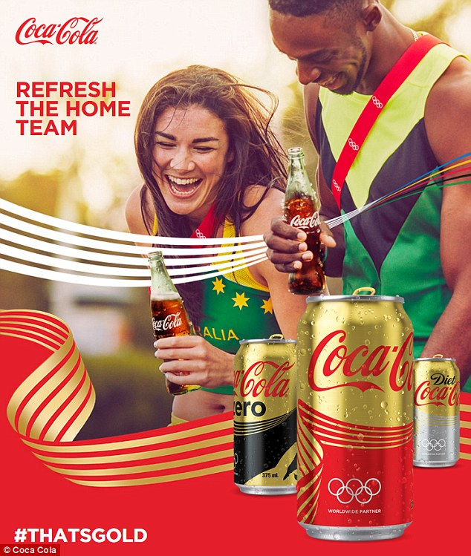
Marketing Implications
2
4P Marketing Mix
Promotion Strategy
Aggressive marketing
Unique and specific theme
Sponsorship
Ex) NASCAR, NBA, NCAA, Olympic Games, FIFA worldcup
Various CSR activities
Support environmental and social issues across the globe
Notes:
audio측면에서 설명하려 한다.
‘우리가 해석하기로는’ 전체적으로 광고의 주제는 - We are different but there is coke for we 이다.
코카는 upbeat노래를 배경으로 말이 주를 이루어 광고를 이끔으로서 표현
구체적으로
Let’s see this with watching the ad one more time.
중간에 음악을 잠깐 멈추고 ‘That’s why there’s just one me’ 라 함으로써
그만큼 이 세상에 나는 단 하나다 라는 것을 강조하면서도
마지막에 But there is coke for we and us. Coke for you 라 함으로써
우리를 위한 coke라는 것을 되새겨준다.
Hi I am Jihyun Lee and I will talk about tones and moods in aspect of audio.
As our interpretation, the topic of this advertisement is this.
‘We are all different but there is coke for we.’
To express this, they use different voices per phrase.
Also Coca-cola show this topic by using upb
Then let’s see more specific things with watching the Ad one more time.
Did you hear this? By pausing the music for a while, they make the sentence ‘That’s why there’s just one me.’ more impressive.

Slide 18
Marketing Implications
2
4P Marketing Mix
Pricing Strategy
Operation-oriented pricing strategy
Price variations to match the supply and demand in a particular regional market
Profit-oriented pricing through optimization of mass production and distribution
Leadership pricing tactic
Market leadership, distribution efficiency, and promotional capabilities
Oligopoly – Coca-Cola and Pepsi are the dominant player
Notes:
audio측면에서 설명하려 한다.
‘우리가 해석하기로는’ 전체적으로 광고의 주제는 - We are different but there is coke for we 이다.
코카는 upbeat노래를 배경으로 말이 주를 이루어 광고를 이끔으로서 표현
구체적으로
Let’s see this with watching the ad one more time.
중간에 음악을 잠깐 멈추고 ‘That’s why there’s just one me’ 라 함으로써
그만큼 이 세상에 나는 단 하나다 라는 것을 강조하면서도
마지막에 But there is coke for we and us. Coke for you 라 함으로써
우리를 위한 coke라는 것을 되새겨준다.
Hi I am Jihyun Lee and I will talk about tones and moods in aspect of audio.
As our interpretation, the topic of this advertisement is this.
‘We are all different but there is coke for we.’
To express this, they use different voices per phrase.
Also Coca-cola show this topic by using upb
Then let’s see more specific things with watching the Ad one more time.
Did you hear this? By pausing the music for a while, they make the sentence ‘That’s why there’s just one me.’ more impressive.

Slide 19
STANDARDIZATION
LOCALIZATION

Slide 20
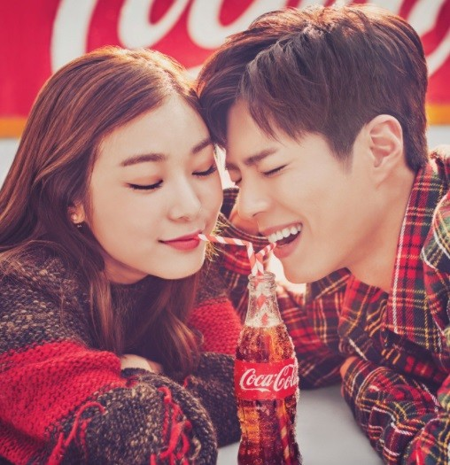
Standardization & localization strategy
3
Standardization & Localization strategies of Coca-Cola
Standardization (Globalization)
Approach with ‘consistent marketing
method’ toward overall market
Localization (Adaptation)
Using ‘Adjust and implement marketing
methods’ differently depending on
country or region

Slide 21
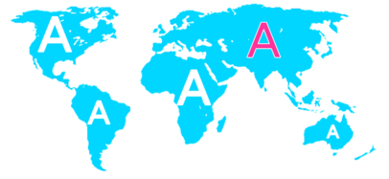
Standardization & localization strategy
3
Standardization of Coca cola (Globalization)
Developing standardized products marketed worldwide with a standardized marketing mix
Essence of mass marketing
ex) 4 techniques for brand image
1) Name
2) logo
3) Santa Claus & Polar bear
4) Contour bottle

Slide 22
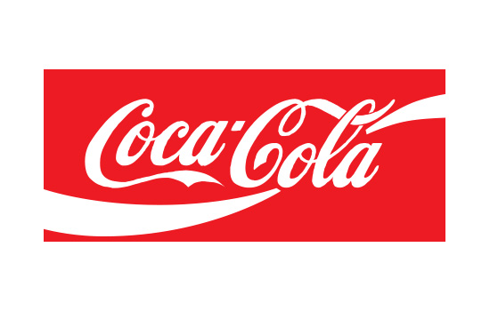
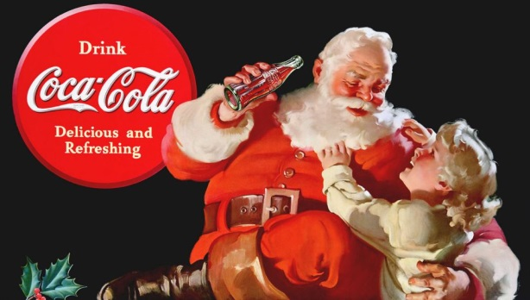
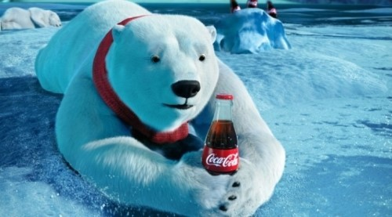
Standardization & localization strategy
3
Standardization of Coca cola (Globalization)
Logo
Santa Claus
Polar Bear

Slide 23
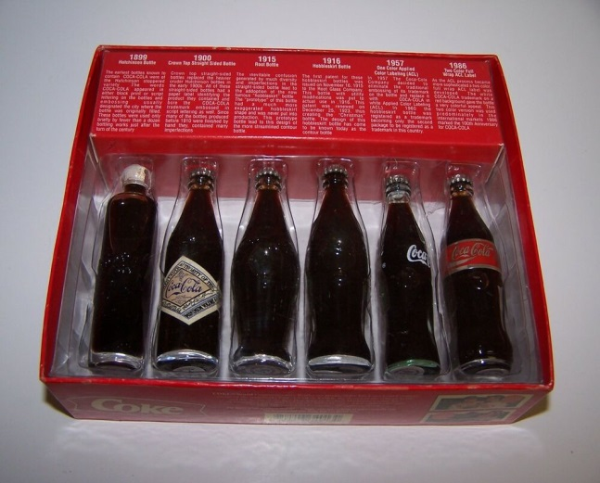
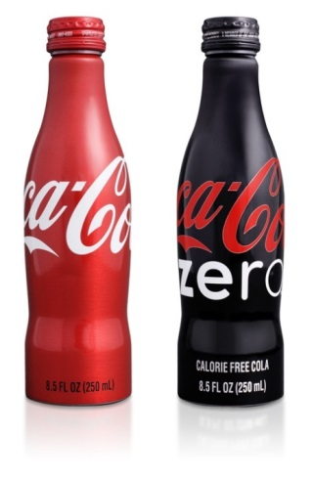
Standardization & localization strategy
3
Standardization of Coca cola (Globalization)
Contour Bottle
Worth 4 trillion Won only with the design
Two conditions for design

Slide 24
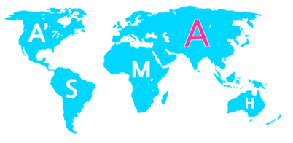
Standardization & localization strategy
3
Localization of Coca cola (Adaptation)
Mixing standardization and customization in a way that minimizes costs while maximizing satisfaction
Slogan: Think locally, act locally.

Slide 25
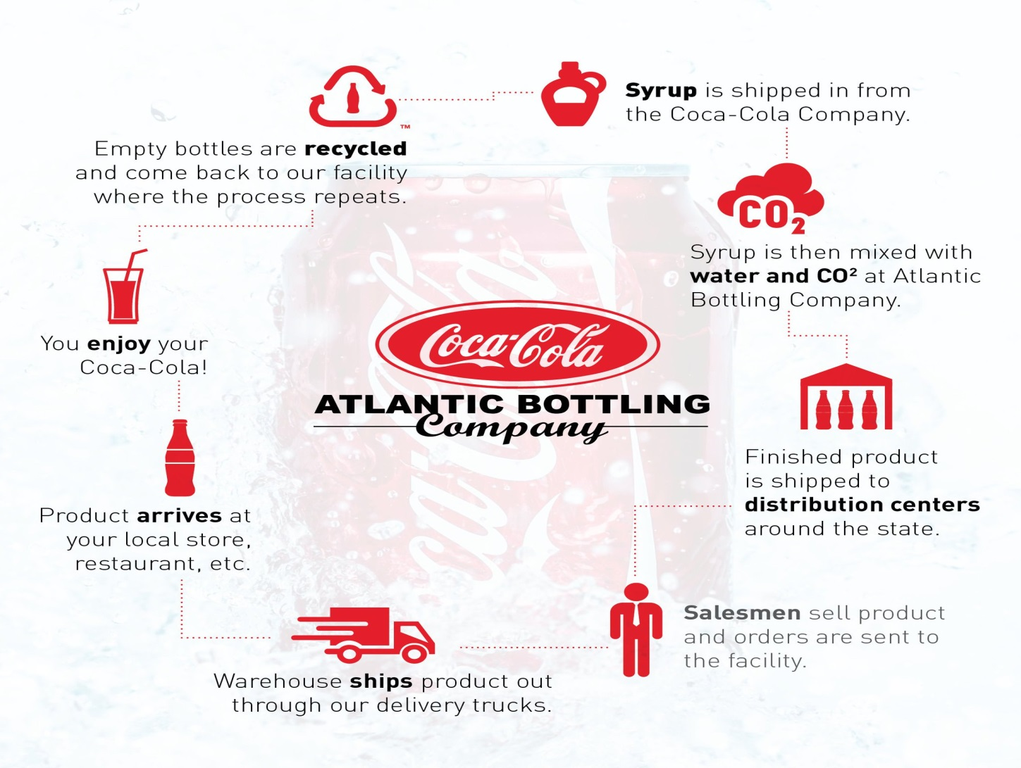
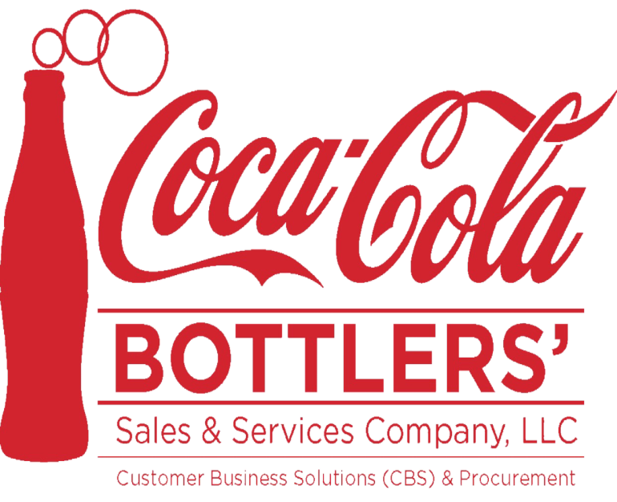
Standardization & localization strategy
3
Localization of Coca cola (Adaptation)
1. Bottling system

Slide 26
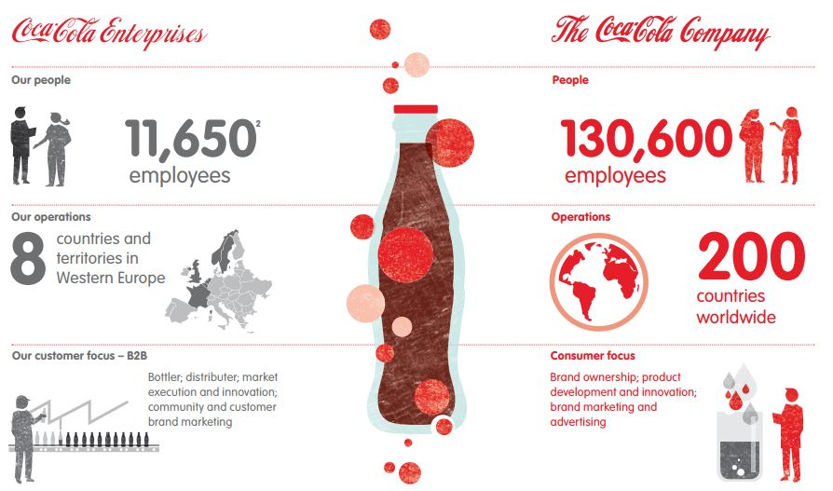
Standardization & localization strategy
3
Localization of Coca cola (Adaptation)
2. Resource localization

Slide 27
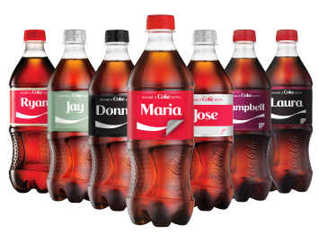
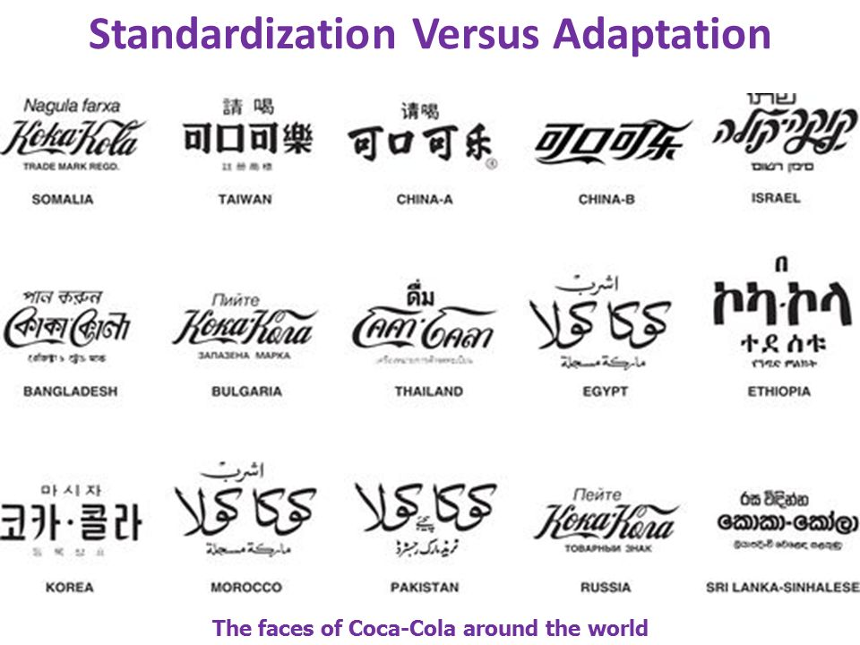
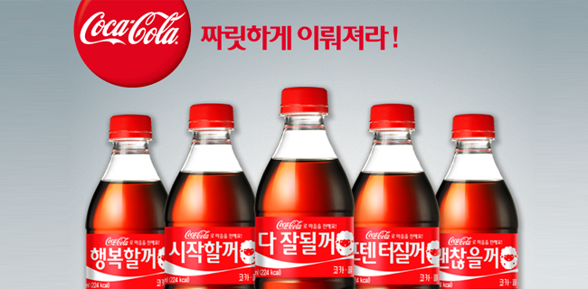
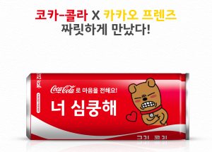
Standardization & localization strategy
3
Localization of Coca cola (Adaptation)

Slide 28
AUSTRALIA’S
SUCCESS & FAILURE

Slide 29

Australia’s success & failure
4
Brief introduction
Started in 1938.
Coca-Cola AMATIL, Sydney
27 non-alcoholic beverages

Slide 30
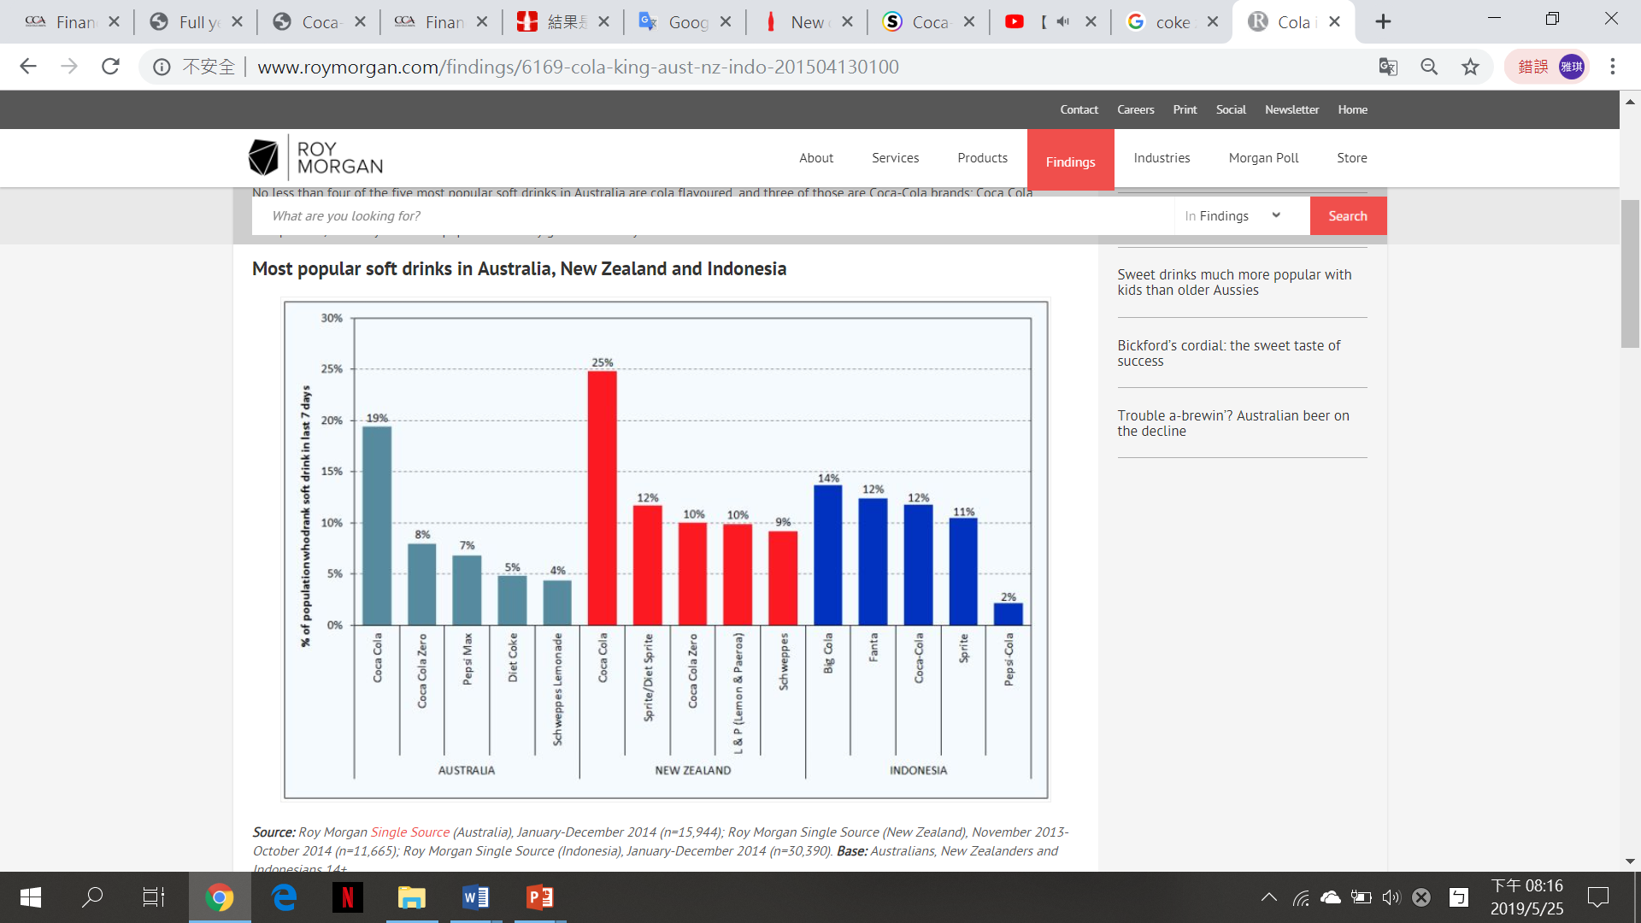
Australia’s success & failure
4
Coca-Cola Amatil
2018 EBIT $388.3m
Top 3 food company in Australia
Coca-Cola vs pepsi

Slide 31
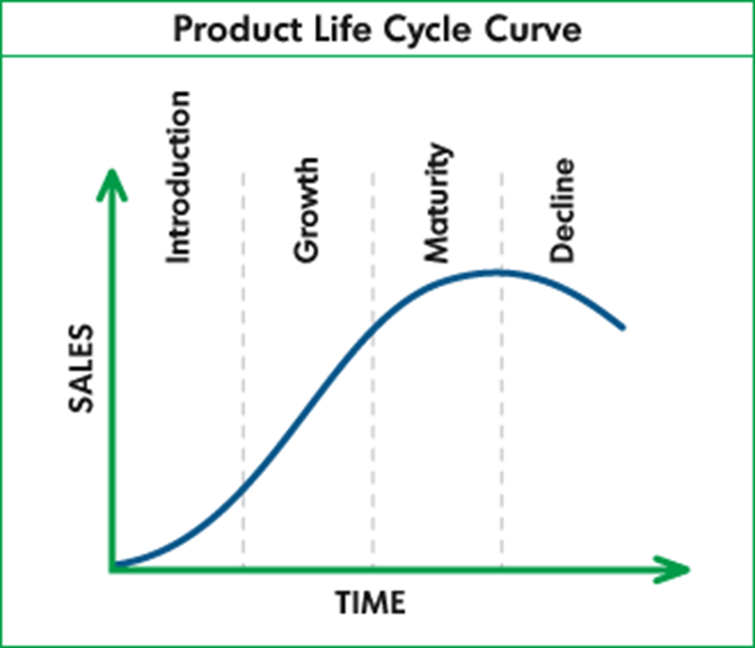
Australia’s success & failure
4
Coca-Cola in Australia
Maturity period
Consumer demand
Competitors in soft drink market
Share a coke campaign in 2011

Slide 32
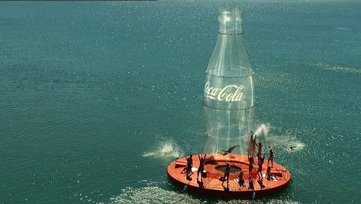
Australia’s success & failure
4
Background of share a coke
Young adults felt they were not talking to them at eye level
50% of Australian teenagers hadn’t had cokes in the previous month
After “Bottle Blast”
Too familiar, too predictable

Slide 33
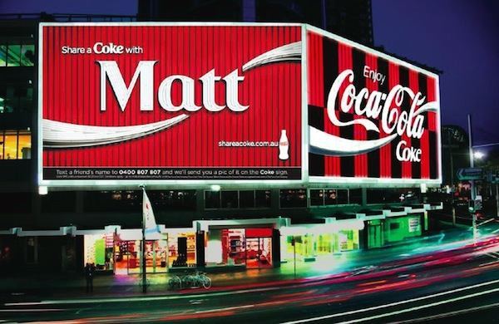
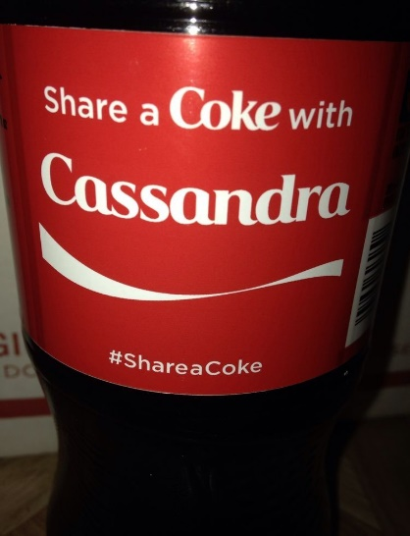
Australia’s success & failure
4
The start of share a coke
2011 summer in Australia
150 names, 42% Australian
The concept of sharing
big bang across multiple channels
150 name songs
iconic digital sign at King’s Cross in Sydney

Slide 34
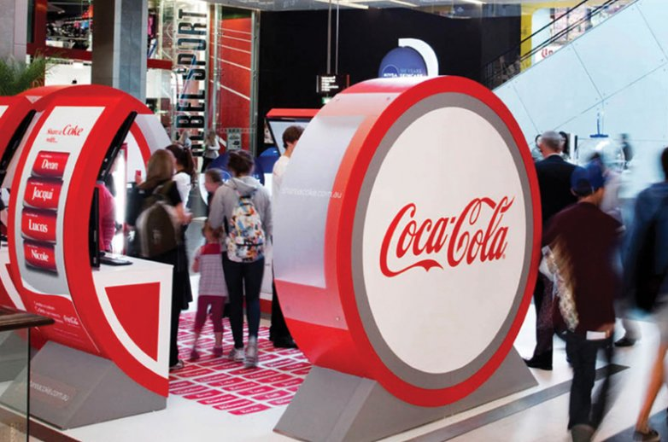
Australia’s success & failure
4
The booming of share a coke
Kiosks to personalize their own Coke can
requests to publish more names
50 new names

Slide 35
Australia’s success & failure
4
The success of share a coke
7% increase in young adult consumption
5% more people drinking coke
870% increase in Facebook traffic
12,020,000 earned media impressions
76k virtual coke cans shared
378k extra coke cans printed at kiosks
2 out of 5 Australians bought a Share a Coke pack
a positive image of Coca-Cola as a brand.

Slide 36
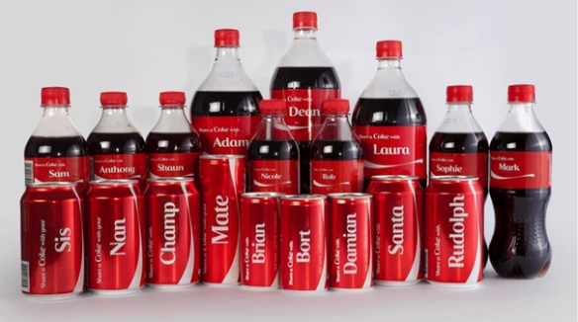
Australia’s success & failure
4
The reasons of success
The Brand personally connected with Consumers
“Share a Coke” had a powerful CTA (call-to action)
The Campaign is regularly updated
Research Target Market
Coca-Cola is an extremely iconic brand

Slide 37
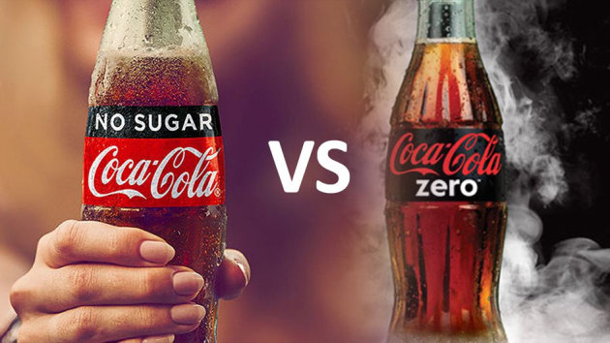
Australia’s success & failure
4
Coke no sugar in Australia
Launch in 2017
Coke no sugar vs. Coke zero
Success or failure

Slide 38
Australia’s success & failure
4
Recent in Australia
reduce 20% sugar by 2025
less sugar for 22 beverages
10% by 2020, 20% by 2025
100% recyclable packaging by 2025.

Slide 39
CHINA’S
SUCCESS & FAILURE

Slide 40



China’s success & failure
5
Coca-Cola’s success in Chinese market
Cooperate with China Oil & Foodstuffs Corporation (COFCO) and Swire Group, which responsible for bottling business
The annual profit in China last year is $230 million.

Slide 41
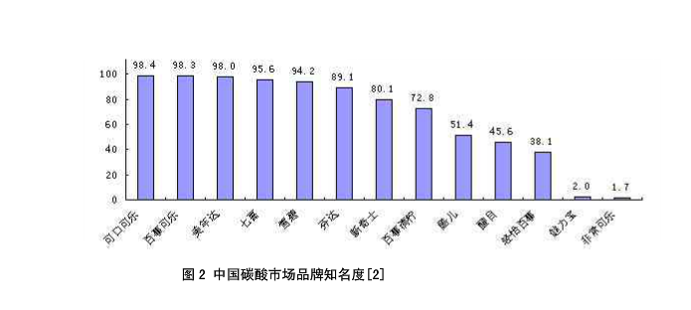
China’s success & failure
5
Coca–Cola’s success in Chinese market
The development of Coca-Cola in China can be divided into two stages.
1927 - 1949
1978 - Now
The world's largest market for "Minute Maid", and No. 1 brand of fruit juice beverages in China.
Has the highest brand awareness in China's beverage market.

Slide 42
China’s success & failure
5
Coca–Cola’s success in Chinese market - reasons
Seize the Opportunity of “Reform and Opening”
China has a large population, leading to low labor cost and high market potential.

Slide 43
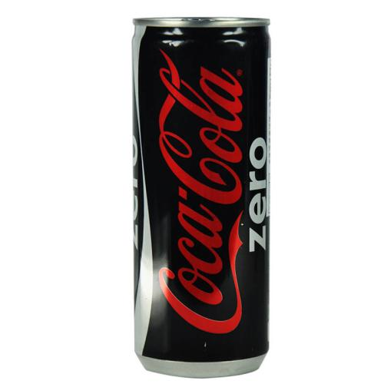
China’s success & failure
5
Coca–Cola’s failure in Chinese market
Chinese consumers' preferences gradually changed
The sales of Coke Zero were unsatisfactory in China.
The performances of some brands introduced into the Chinese market such as GEORGIA and Aquarius has not met expectations.

Slide 44
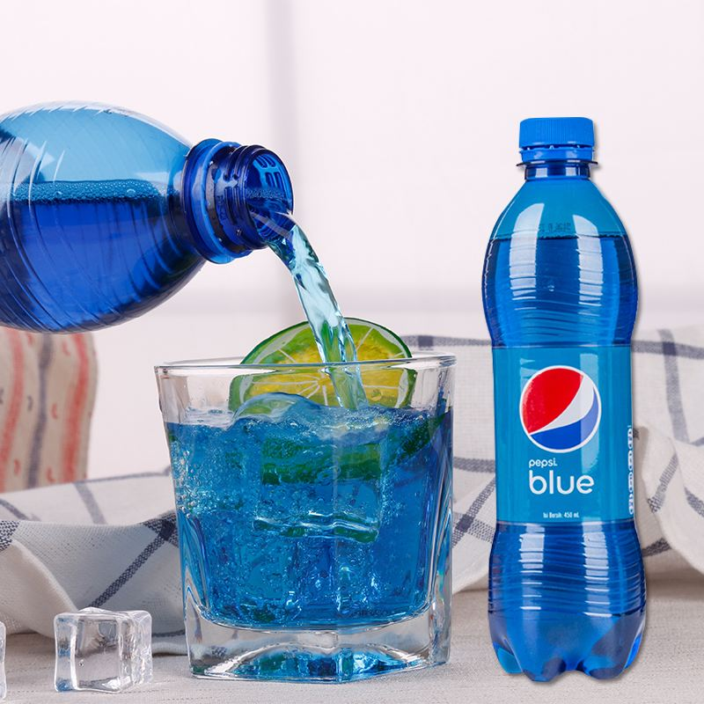
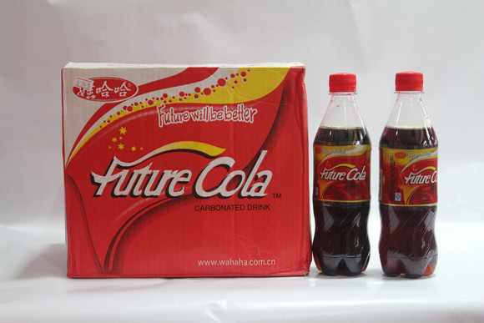
China’s success & failure
5
Coca-Cola’s failure in Chinese market - reasons
The decline of the consumption of carbonated beverages has become an inevitable trend in Chinese market
Successful Share-growth strategy of its main competitor in China - Pepsi-Cola.
Aging population and antitrust policy

Slide 45
SWOT
ANAYSIS

Slide 46
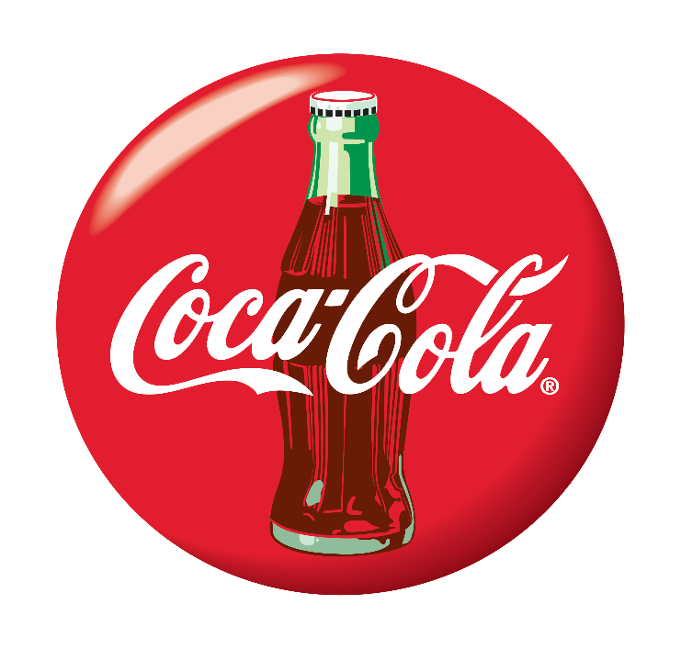
SWOT analysis
6
SWOT - Strengths
Brand Equity
Distribution network
Company valuation
Customer Loyalty
Vast global presence
Fantastic marketing strategies
Largest market share

Slide 47
SWOT analysis
6
SWOT - Weaknesses
Water management
Competition with Pepsi
Absence in health beverages
Narrow segmentation

Slide 48
SWOT analysis
6
SWOT - Opportunities
Diversification
Market the lesser selling products
Increasing Coffee Market
Supply chain improvement
Packaged drinking water

Slide 49
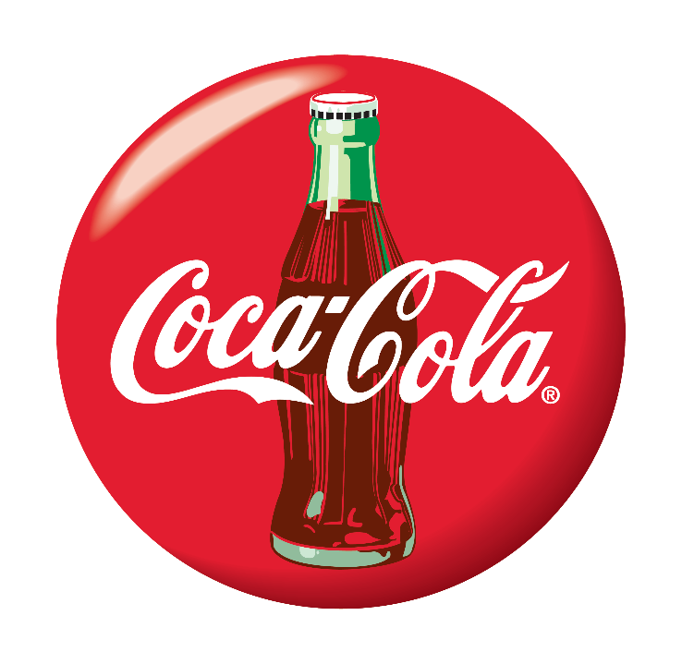
SWOT analysis
6
SWOT - Threats
Indirect competitors
Raw material sourcing

Slide 50
SUGGESTIONS

Slide 51
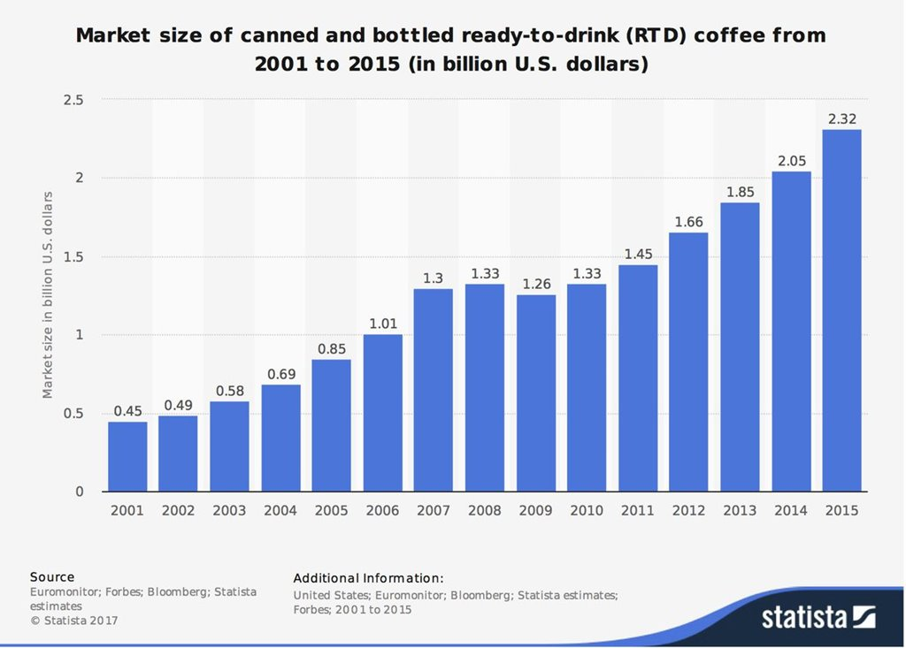
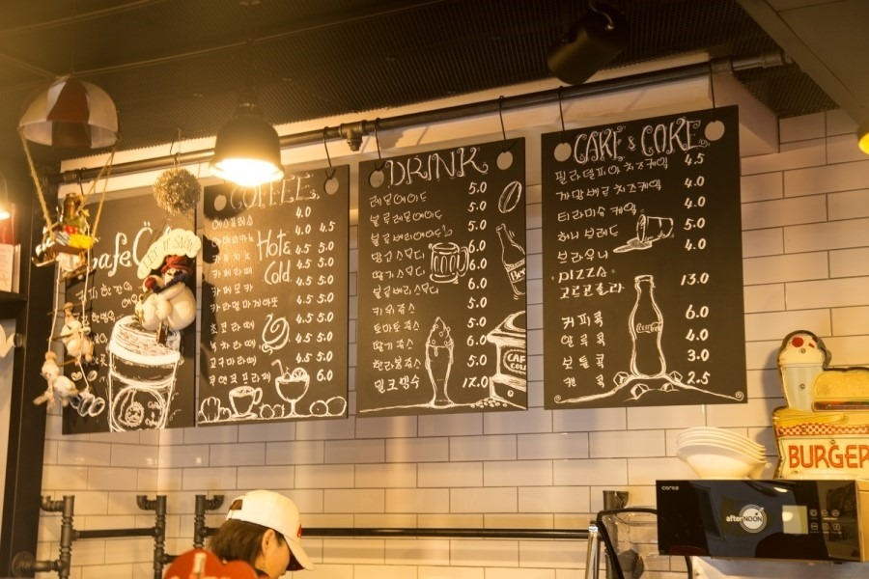
Suggestions
7
Producing RTD coffee
for a Costa Cofee brand
Focus on the Costa Coffee
menu development

Slide 52
CONCLUSION

Slide 53
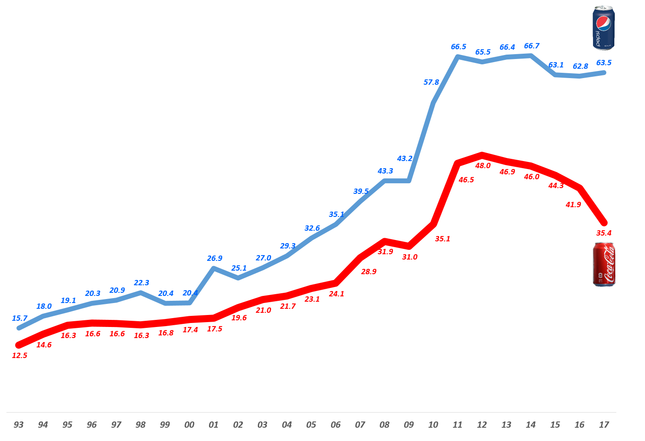
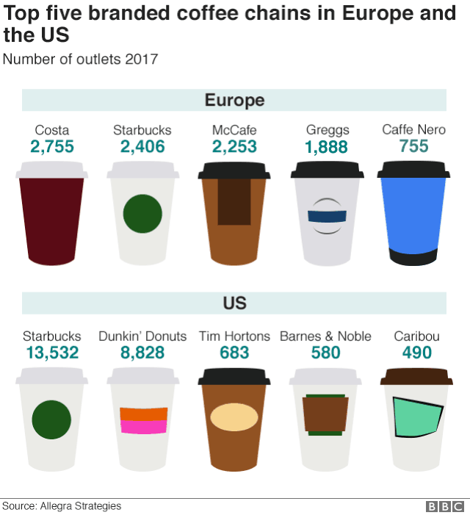
Conclusion
8
Annual sales trends of Coca-cola and Pepsi

Slide 54
Q&A

Slide 55
